Slide 1
XtremeCS 2nd Workshop
2nd of July, 2015 16:30 to 18:30 (or more)
Rajith Vidanaarachchi

Slide 2
Answer for Practice Problem
In an infinitely looping Linked List, find the node where the loop starts.
Constraints :
Time Complexity = O(n)
Space Complexity = O(1)

Slide 3
Tortoise & Hare (Floyd’s Cycle Detention) Algo
μ
λ
Notes:
Explanation on board Tortoise at 1/step ; Hare at 2/step
Meet at v steps
v = mu + k1 lambda + sigma
2v = mu + k2 lambda + sigma
v = (k2 – k1) lambda
Torotoise to the beginning -> 1/step; Hare 1/step (Hare ahead by 2v)
At time inf. both Hare and Tortoise at the same position.

Slide 4
Today’s Outline
BFS (Breadth First Search)
Flood Fill
DP (Dynamic Programming)
(If time permits OR if you guys can stay until late 🌙)

Slide 5
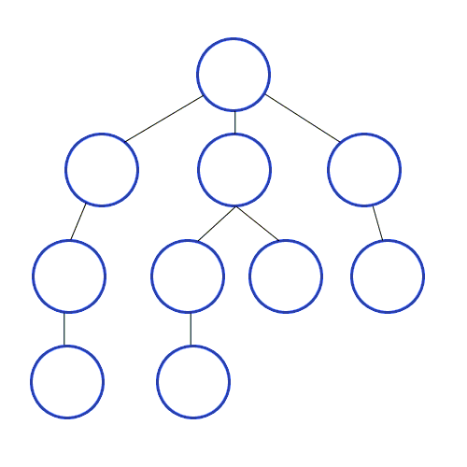
BFS – Breadth First Search
https://commons.wikimedia.org/wiki/File:Breadth-First-Search-Algorithm.gif
Notes:
Details on BFS
- Branching Factor
- keeping a queue

Slide 6
BFS – Practice Problem
Capture Them All TopCoder, SRM 207, Round I Div II Level 3
Q(ueen) and R(ook) does not move
How many moves for the K(night) to capture both Q and R
Q
R
K

Slide 7
K

Slide 8

Flood Fill
http://inventwithpython.com/blog/

Slide 9
Flood Fill – Practice Problem
GrafixMask : Top Coder SRM 211 Round 1 - Division I, Level Two

Slide 10



Given a 300 x 500 Image, and a set of Rectangular bit masks, Find:
1) No of Contiguous Areas
2) Areas (in pixels) of them
Notes:
1) {"0 292 399 307”} => Returns: { 116800, 116800 }
2) {"48 192 351 207", "48 392 351 407", "120 52 135 547", "260 52 275 547”} => Returns: { 22816, 192608 }
3) {"0 192 399 207", "0 392 399 407", "120 0 135 599", "260 0 275 599”} => Returns: { 22080, 22816, 22816, 23040, 23040, 23808, 23808, 23808, 23808 }

Slide 11
Money Problem
Pay a given sum in least number of coins/notes
Pay 43 Rs.

Slide 12
7

Slide 13
4

Slide 14
Greedy Algorithm
A Greedy algorithm is based on the assumption that a locally optimal solution is globally optimal.
Pay with the biggest note / coin available, which is less than the amount you want to pay. Continue like this, until you pay off.

Slide 15
Pay : 100
Coins: 90, 80, 20, 1
Greedy Solution: 90 x 1, 1x10 => 11
Optimal Solution: 80 x 1, 20x1 => 2

Slide 16
DFS with Recursion
Diagram on Board
How can we improve this?
How can we improve this more?
How can we improve this even more?
Notes:
Start with paying larger coins
Order of paying doesn’t matter
Note the redundancies, and move on to DP

Slide 17
Dynamic Programming
Problem can be divided into sub problems.
Answers to the main problem can be derived from the sub problem’s answers.
Sub problems are repeated.
Trading off memory for time.

Slide 18
DP for the Money Problem
Identify the sub problem.
How to minimize the search tree.
More details on board.

Slide 19
Thank You!
Code, Presentation and Problem Statements available at:
https://github.com/rajithv/XtremeCS2

Slide 20
Other Important Algorithms
Graph Related :
Shortest Path
Dijkstra’s
Floyd-Warshall
Minimum Spanning Tree
Kruskal’s
Prim’s
Network Flow
Ford-Fulkerson
Optimization
Alpha-Beta pruning
Mini-Max trees
DFS – Iterative Deepening
Largest Ascending Subsequence
Knapsack
Optimal Pair Matching
Other Techniques
Big Integers
Using standard Data Structures effectively
Effective Representation of Data
String Manipulation
Debugging Effectively
Practice Problems :
USACO
TopCoder
Codechef
Hackerrank

